Slide 1
Technology for Success: Computer Concepts

Slide 2
Module 6
Security and Safety

Slide 3
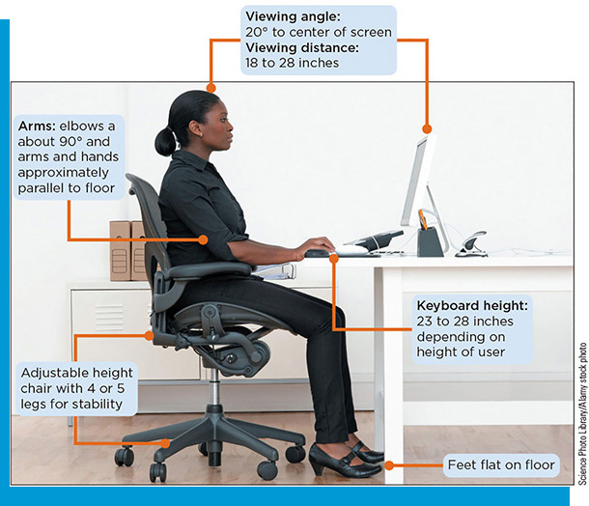
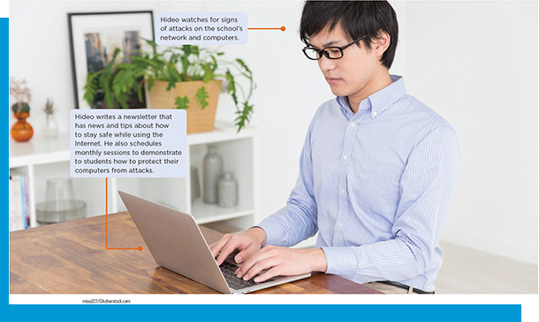
Lesson Objectives
Discuss computer safety and health risks
Use protective measures to safeguard computers and data

Slide 4
Discuss Computer Safety and Health Risks
Determine the risks to computer security and safety
Understand the risks to physical, behavioral, and social health
Describe common cybersecurity attacks

Slide 5
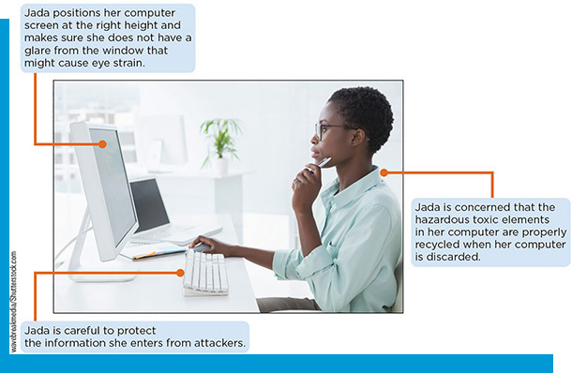
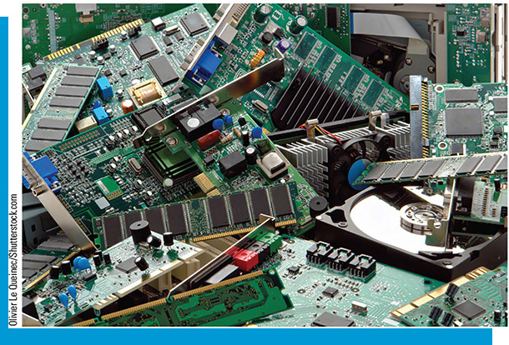
The Risks to Computer Security and Safety (1 of 5)
Three main types of hazards from computers
Information: data and programs, comes from attackers who want to steal information
Environment: toxic electronic components of computers and other digital devices that are exposed when devices are discarded
Health: eye strain, poor posture when using devices, and muscle fatigue from keyboard typing

Slide 6
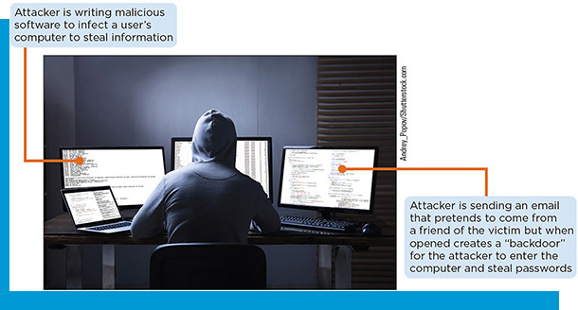
The Risks to Computer Security and Safety (2 of 5)
Risk
The possibility something might occur that results in an injury or a loss
Attackers
Script kitties
Hactivists
Cyberterrorists
Nation state actors
Insiders

Slide 7
The Risks to Computer Security and Safety (3 of 5)
Online Risks
Online banking
E-commerce shopping
Fake websites
Social media sites
Data mining

Slide 8
The Risks to Computer Security and Safety (4 of 5)
Protecting Personal Information
Give only necessary information when completing an online form
Review the information that online sites such as Google, Facebook, Microsoft, and others have stored about you
Request to be removed from mailing lists
Create another email account to use when a merchant or website requires an address
Do not use your social media account login information to log in to another site

Slide 9
The Risks to Computer Security and Safety (5 of 5)
Environmental Risks
E-waste
Sustainable Electronics Management (S E M) promotes the reduction of e-waste
Table 6-2: S E M action steps
step | Action | Description
1 | Buy green | When purchasing new electronic equipment buy only products that have been designed with environmentally preferable attributes.
2 | Donate | Donate used but still function equipment to school, charity, or non-profit organization.
3 | Recycle | Send equipment to a verified used electronics recycling center.

Slide 10
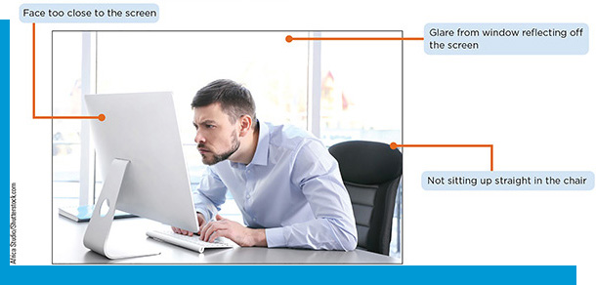
Risks to Physical, Behavioral, and Social Health (1 of 3)
Risks to Physical Health
Repetitive strain injury (R S I)
Table 6-4: Cause and examples of R S I
Cause | Description | Example
Repetitive activity | Repeating the same activity over a length time period | Typing on a keyboard for multiple hours every day over several years
Improper technique | Using the wrong producer or posture | Slouching in a chair
Uninterrupted intensity | Performing the same high-level activity without frequent periods of rest | Working at a computer all day with no breaks

Slide 11
Risks to Physical, Behavioral, and Social Health (2 of 3)
Risks to Behavioral Health
Technology addiction
Sedentary lifestyle
Psychological development
Social interaction

Slide 12
Risks to Physical, Behavioral, and Social Health (3 of 3)
Risks to Social Health
Cyberbullying
Bullying that takes place on technology devices using online social media platforms, public online forums, gaming sites, text messaging, or email
Considered more harmful than general bullying
Cyberstalking
Involves the use of technology to stalk another person through email, text messages, phone calls, and other forms of communication

Slide 13
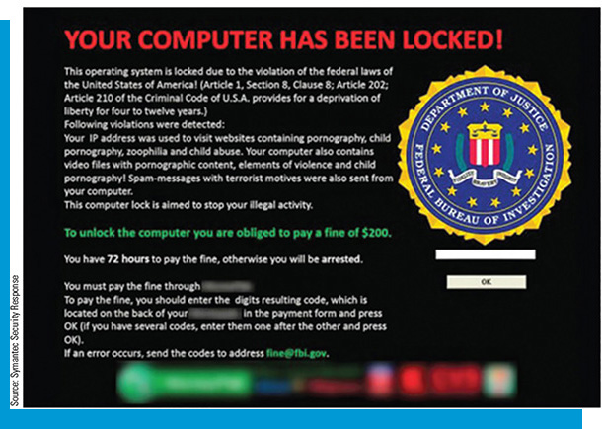
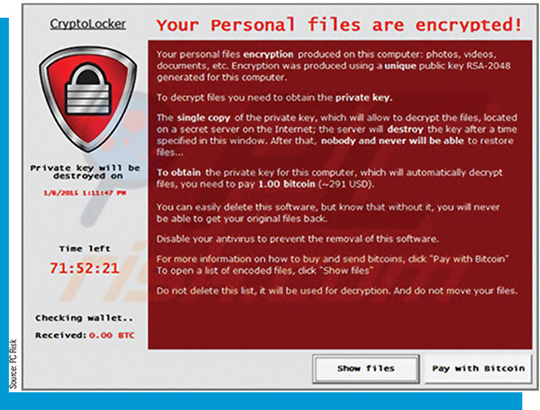
Describe Common Cybersecurity Attacks (1 of 2)
Malicious Software Programs
Malware
Virus
Worm
Trojan
Ransomware
Blocker ransomware
Encrypting ransomware
Address spoofing

Slide 14
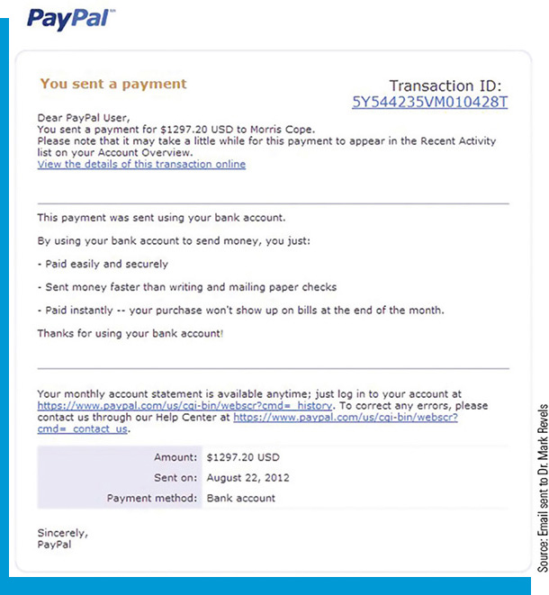
Describe Common Cybersecurity Attacks (2 of 2)
Social Engineering
Attacks that attempts to trick the victim into giving valuable information to the attacker
Social engineering principles, Table 6-6
Phishing
Hoax
Spam

Slide 15
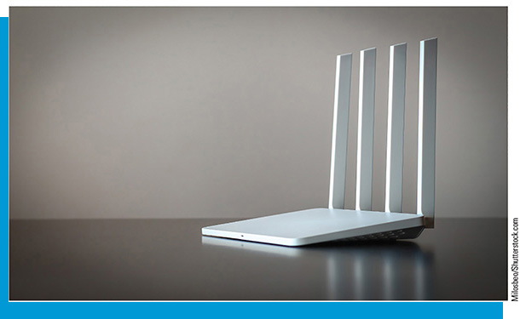
Safeguarding Computers and Data
Explain the steps to protect computer equipment
Protect mobile devices and your privacy
Use strong authentication
Explain the benefits of encryption
Discuss measures to prevent identity theft and protect financial information

Slide 16
Use Common Features of Productivity Apps
Protect yourself while online
Alter Internet settings to secure against security breaches

Slide 17
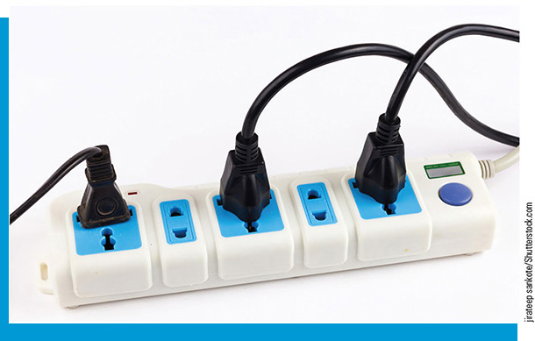
Protect Computer Equipment (1 of 3)
Electrical problems
A surge protector can defend computer equipment from spikes, surges, and noise
An uninterruptible power supply (U P S) can be used to protect against blackouts and brownouts

Slide 18
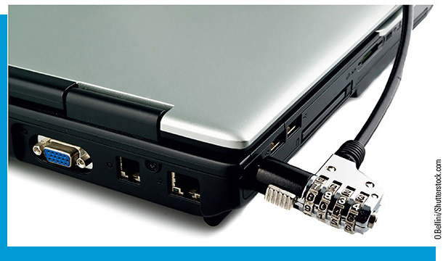
Protect Computer Equipment (2 of 3)
Protect Computers from Theft
To reduce the risk of loss:
Use a cable lock
Keep devices out of sight when in a high-risk area
Avoid being distracted by the device and maintain awareness of surroundings
Hold devices with both hands
Do not use the device on escalators or near train doors
Do not use white or red headphone cords
Do not give chase if a device is stolen
Enable device security features

Slide 19
Protect Computer Equipment (3 of 3)
Perform Data Backups
Creating a data backup means copying files from a computer’s hard drive that are then stored in a remote location
Can protect against hardware malfunctions, user error, software corruption, natural disasters, and cyberattacks
Options: online or to external hard drive

Slide 20
Protect Mobile Devices and Your Privacy (1 of 2)
Wireless Network
Risks
Reading wireless transmissions
Viewing or stealing computer data
Injecting malware
Downloading harmful content
Precautions
Only connect to an approved wireless network in public
Limit the type of activity you do on public networks to simple web surfing or watching online videos.
Configure routers for a high level of security

Slide 21
Protect Mobile Devices and Your Privacy (2 of 2)
Protect Your Privacy
Shred paperwork that contains personal information before discarding
Do not carry a Social Security number in a wallet or write it on a check
Do not provide personal information either over the phone or through an email message
Keep personal information in a secure location in a home or apartment
Be cautious about what information is posted online and who can view your information
Keep only the last 3 months of financial statements and shred older documents
For paper documents that must be retained, use a scanner to create a P D F of the document and add a strong password that must be entered before it can be read
Be cautious with a website or app request to collect data
Websites that request more personal information than would normally be expected should be avoided

Slide 22
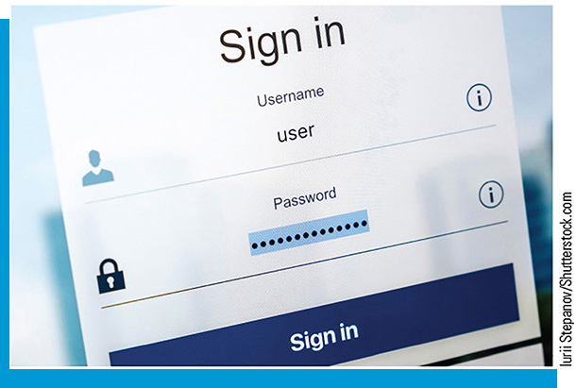
Use Strong Authentication (1 of 3)
Use Strong Passwords
A strong password is a longer combination of letters, numbers, symbols
A longer password is always more secure than a shorter password, regardless of complexity
Most security experts recommend that a secure password should be a minimum of 15-20 characters in length
Other general recommendations:
Do not use passwords that consist of dictionary words or phonetic words
Do not repeat characters or use sequences (abc,123)
Do not use birthdays, family member names, pet names, addresses, or any personal information
Use a password manager

Slide 23
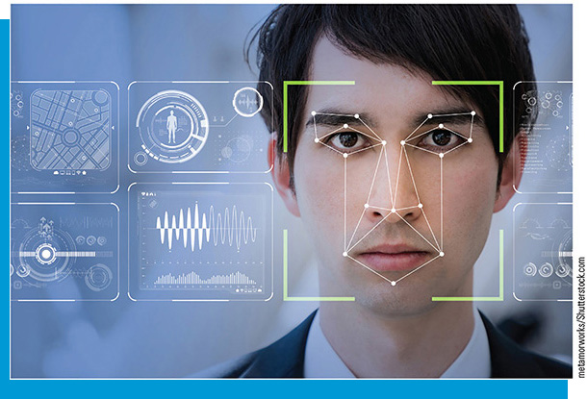
Use Strong Authentication (2 of 3)
Authenticating with Biometrics
Uses the unique characteristics of your face, hands, or eyes to authenticate you. Some of the different types of biometrics that are used today for authentication include:
Retina
Fingerprint
Voice
Face
Iris

Slide 24
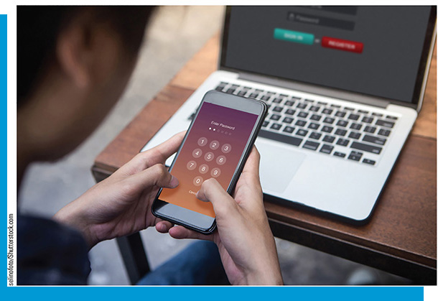
Use Strong Authentication (3 of 3)
Add Two Factor Authentication
Uses two levels of security: passwords and codes
After correctly entering your password, a 4-6 digit code is sent to your cell phone. The code must then be entered as the second authentication method.

Slide 25
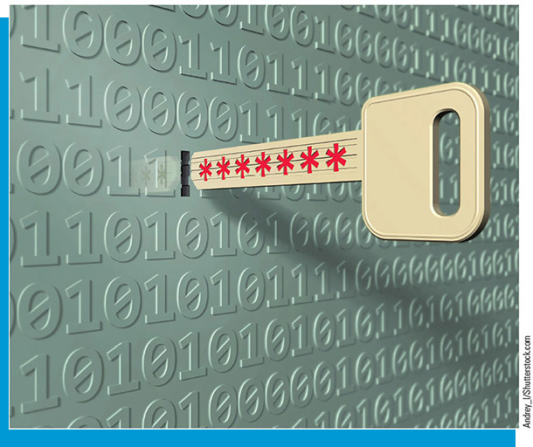
The Benefits of Encryption
Encryption: the process of “scrambling” information so it cannot be read unless the user possesses the “key” to unlock it (decryption)
Can apply to data-at-rest (hard drive) or data-in-transit (Internet)
The encryption key must be kept secure
Digital certificate: a technology used to verify a user’s identity and key that has been “signed” by a trusted third party

Slide 26
Preventing Identity Theft (1 of 2)
Identity theft involves using someone’s personal information to commit financial fraud
Thieves can make excessive charges in the victim’s name
The victim is charged for the purchases and suffers a damaged credit history that can lead to being denied loans for school, cars, and homes

Slide 27
Preventing Identity Theft (2 of 2)
Safeguarding information:
Shred paperwork that contains personal information before discarding it
Do not carry a Social Security number in a wallet or write it on a check
Do not provide personal information over the phone or through email
Keep personal information in a secure location in a home or apartment
Monitor financial statements and accounts:
Be alert to unusual activity in an account
Follow up on calls regarding purchases that were not made
Review financial statements each month carefully as soon as they arrive
Request one free credit report annually to review your credit history
Have a credit put on your credit information so that it cannot be accessed without your explicit permission

Slide 28
Protect Yourself While Online (1 of 2)
Configure Browser Security
Cookies
Scripting
Plug-ins
Pop-ups
Clear browsing data
Plug-in validation

Slide 29
Protect Yourself While Online (2 of 2)
Protecting Your Online Profile
Be cautious about what information you post
Be cautious about who can view your information
Pay close attention to information about new or updated security settings and fine-tune profile options accordingly

